Slide 1
Designing a Robust Hotel Reservation Database
Database Design
INDIANA UNIVERSITY BLOOMINGTON

Slide 2
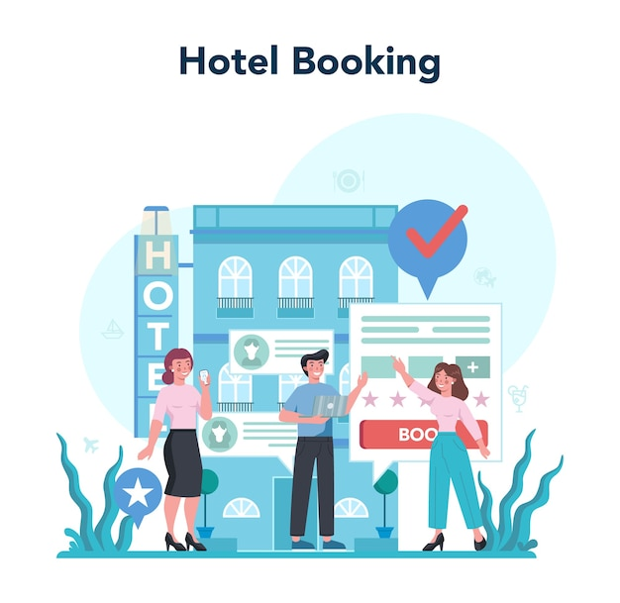
Presentation overview
Data Set Used
Use Cases and Problem Statement
Conceptual Model
Logical Model
Physical Model
Data Analysis - Relational and Graph
Results
Conclusion and Experience
ImageSource- https://www.freepik.com/vectors/hotel-booking

Slide 3
Dataset Used
The data set we are using is a Hotel Reservation dataset which contains about ~36000 Booking Transactions through online channels with upto 20+ column.Some of the major columns are.
a) Booking ID b) Parking Space Required c) Booking_Status --- Cancelled or Not Cancelled d)Room_Type– Booked By the customer e) Meal_Type– Booked By the customer f) Avg_Price of the room booked etc.

Slide 4
Problem Statement and Motivation
The prevalence of online hotel reservation channels has resulted in a shift in customer behavior, leading to a significant increase in cancellations and no-shows. Guests often take advantage of the free or low-cost cancellation policies, causing revenue loss and operational challenges for hotels. Hence, we need to find a solution to address the issue of revenue loss and operational challenges faced by hotels due to an increasing number of cancellations and no-shows.

Slide 5
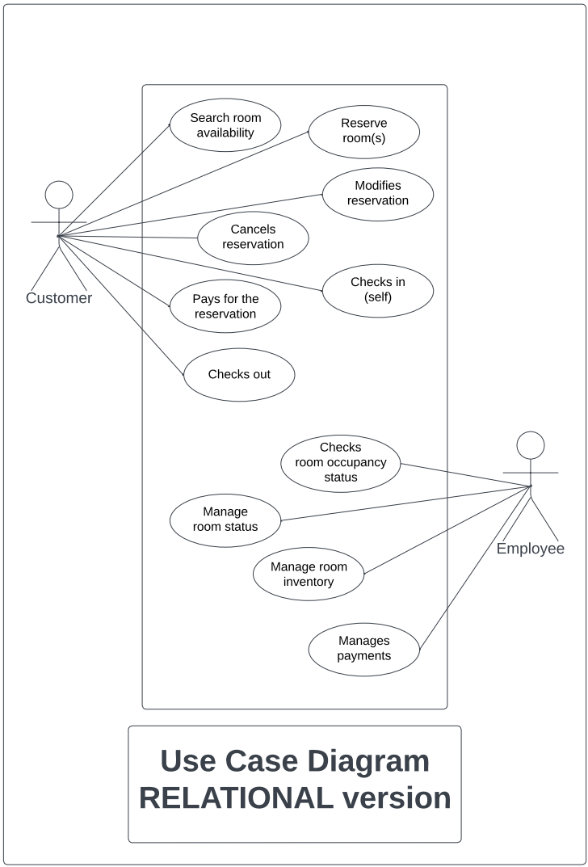
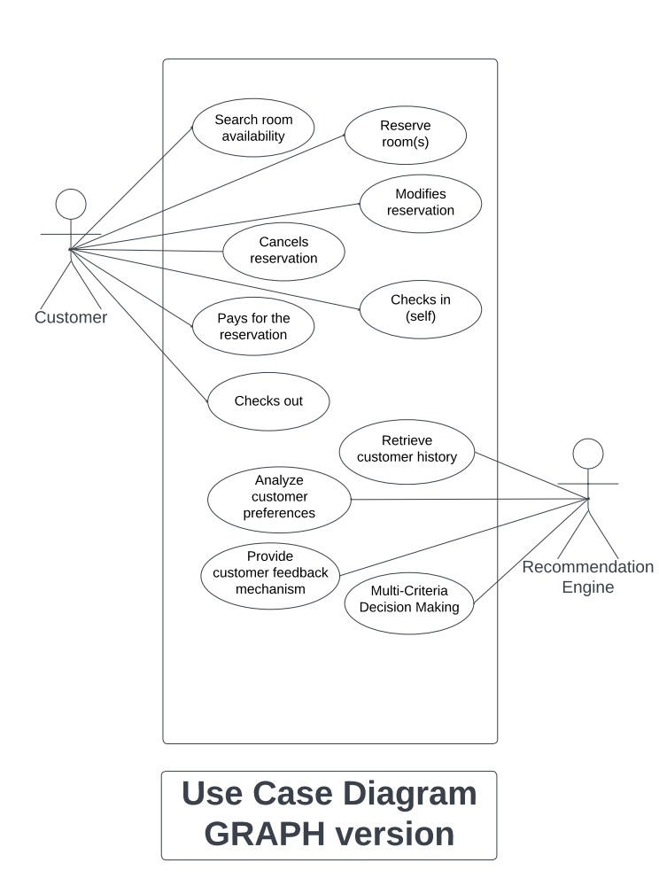
Use Case Diagram

Slide 6
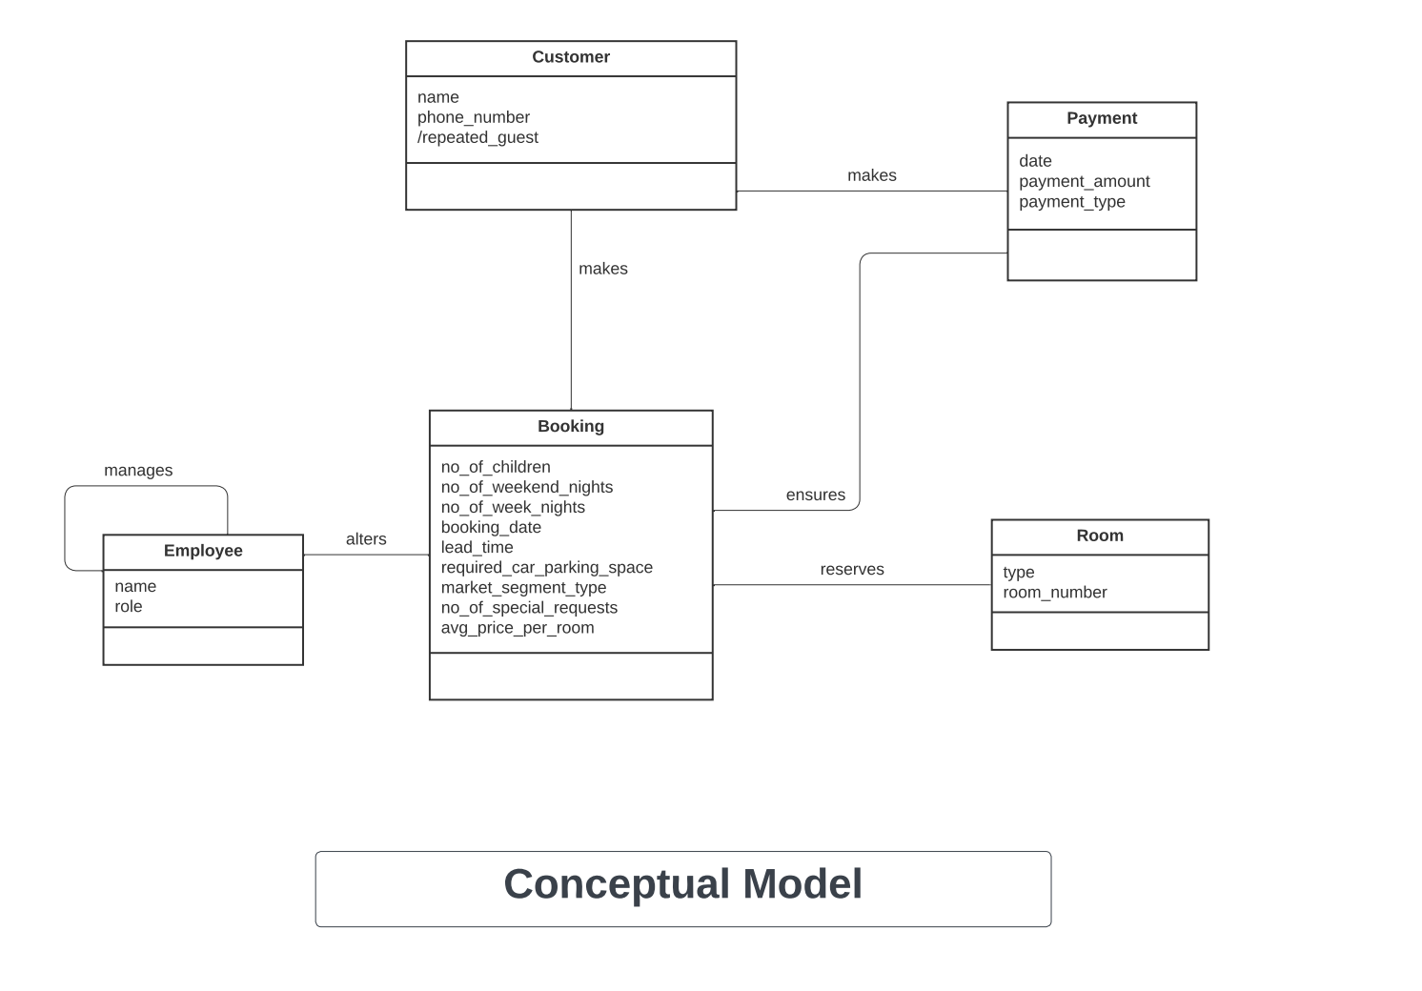
Conceptual Diagram

Slide 7
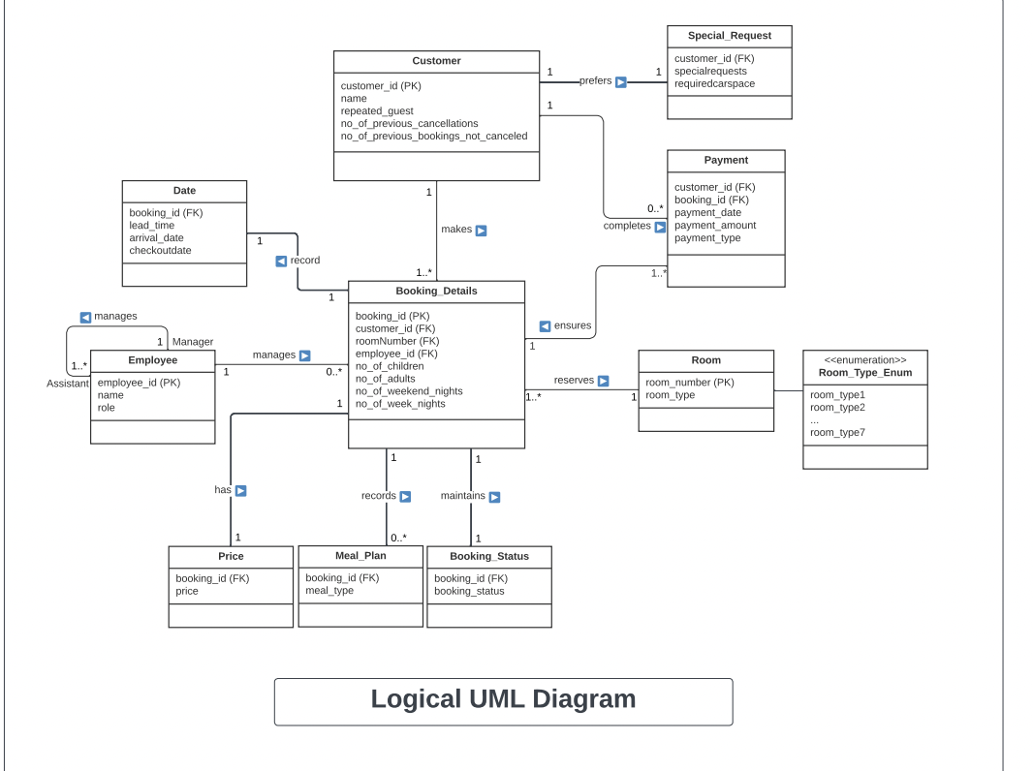
Logical Diagram

Slide 8
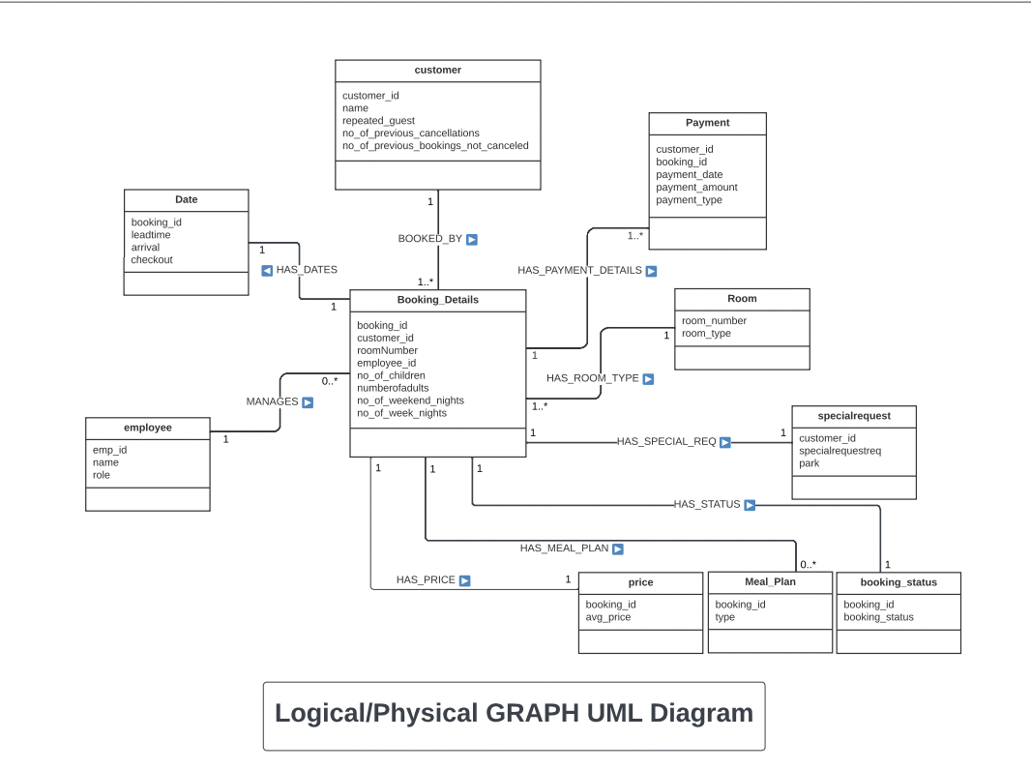
Logical / Physical Diagram Graph

Slide 9
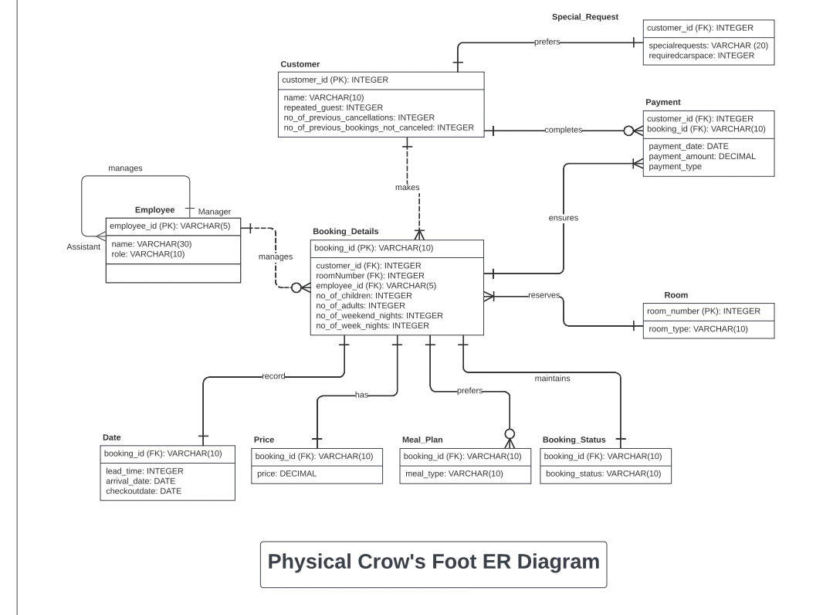
Physical Diagram

Slide 10

Data Analysis for Relational Database

Slide 11
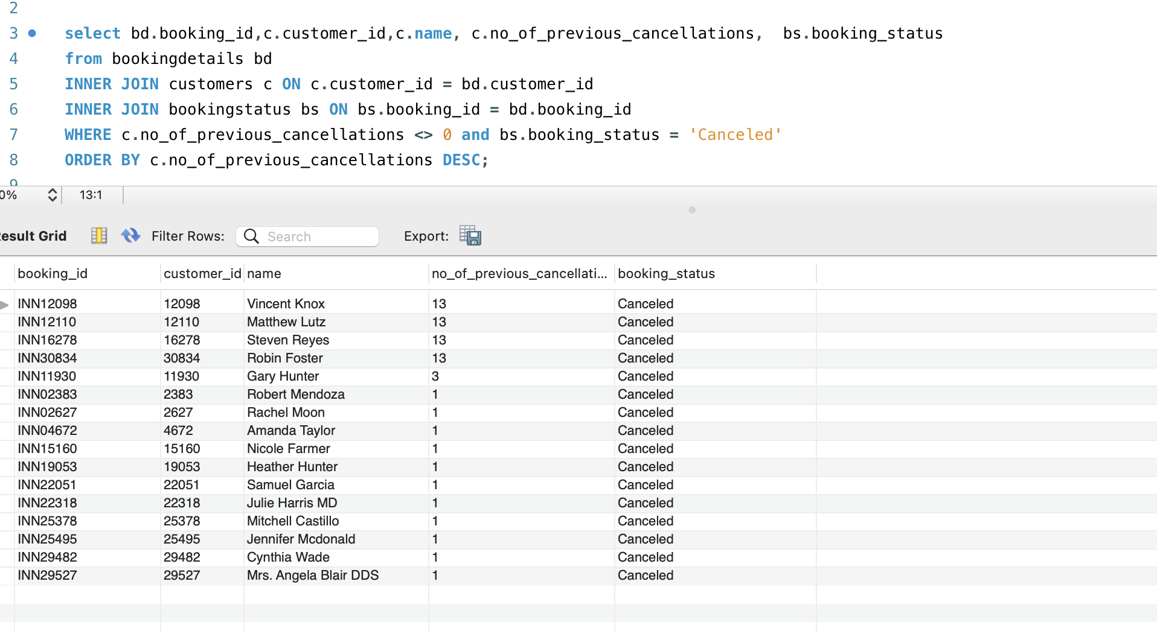
Customers who have cancelled their reservations after booking

Slide 12
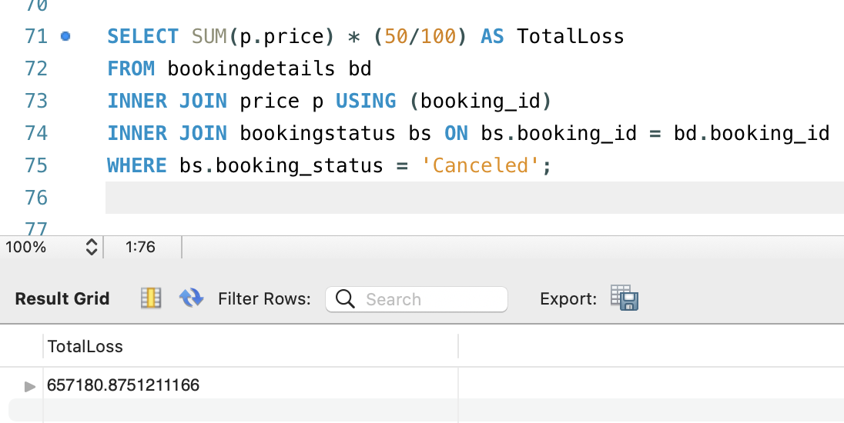
We can see that there are customers who are not loyal at all and have cancelled for more than 5 times. For such customers manager has asked us to take action against them and we can block their accounts from out online reservation site, so that they are not able to do such cancellations which are leading to huge amount of losses for our business.’

Slide 13
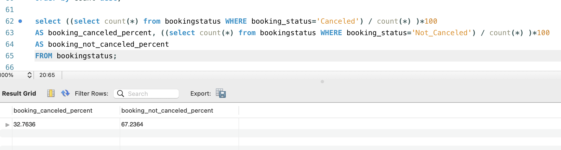
Percentage of People Cancelling vs Not Cancelling

Slide 14
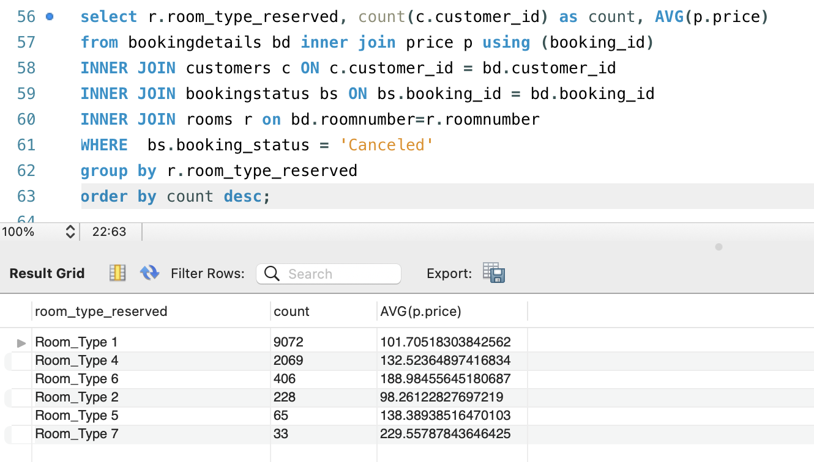
Count of Type of Rooms Cancelled with their Average Price

Slide 15
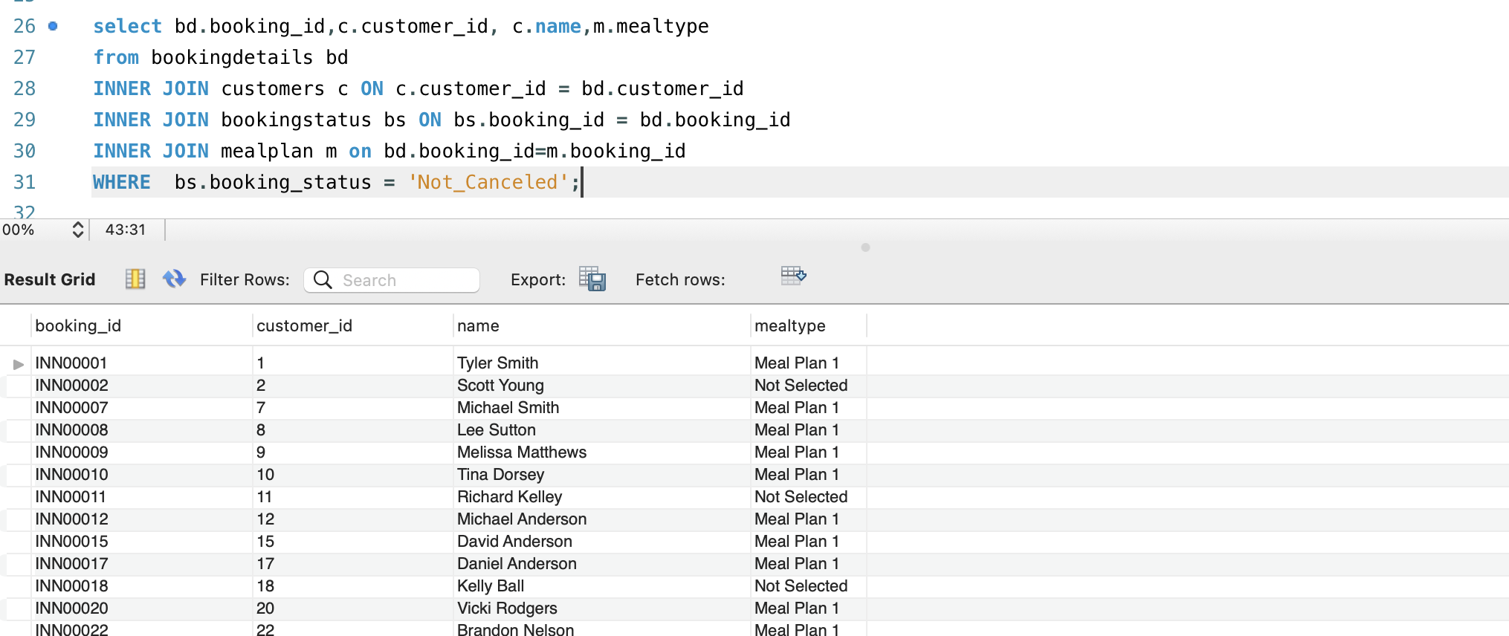
For the Chefs

Slide 16
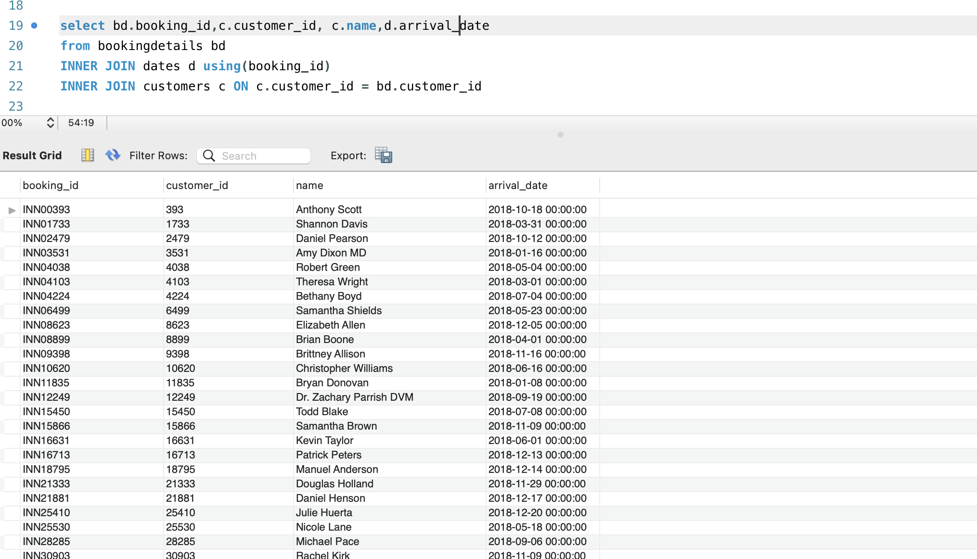
For the Valet’s

Slide 17
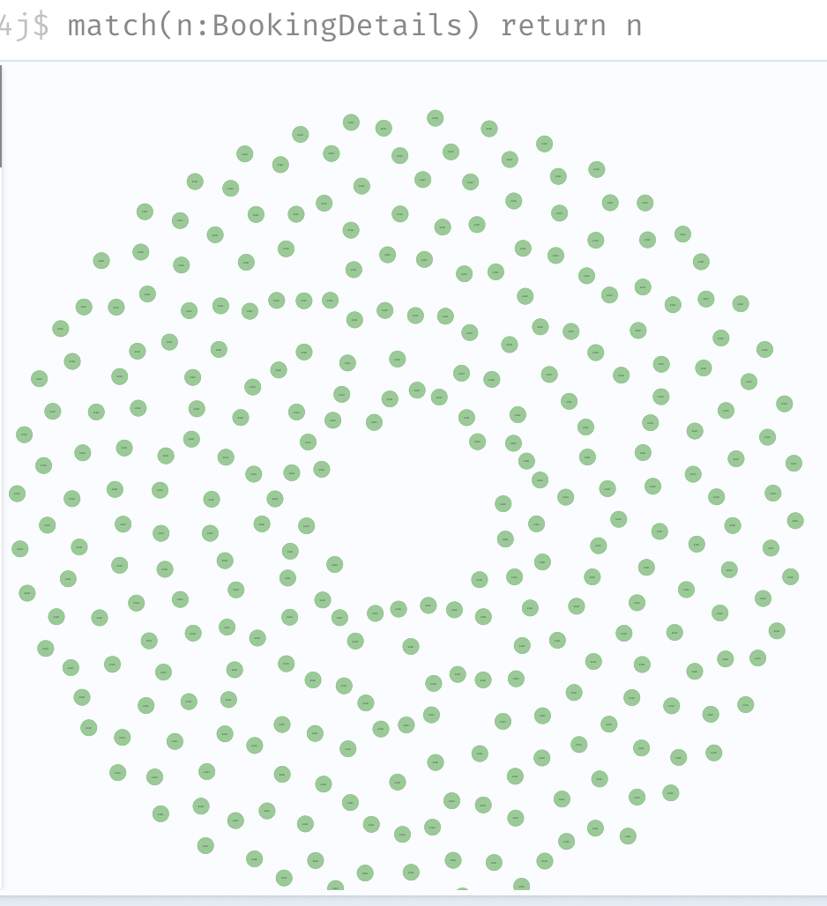
Analysis –Graph DB

Slide 18
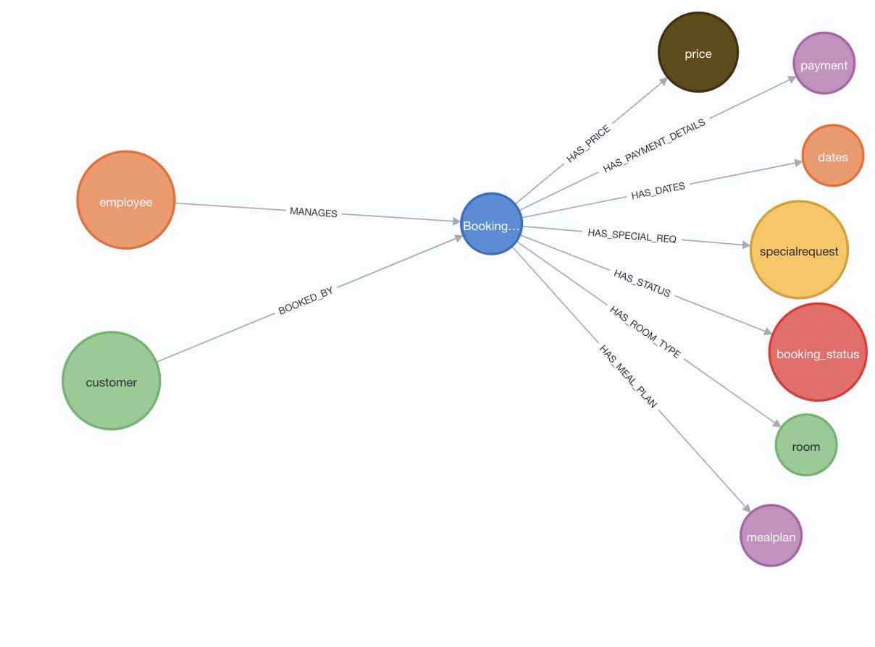
DB Schema Visualization

Slide 19
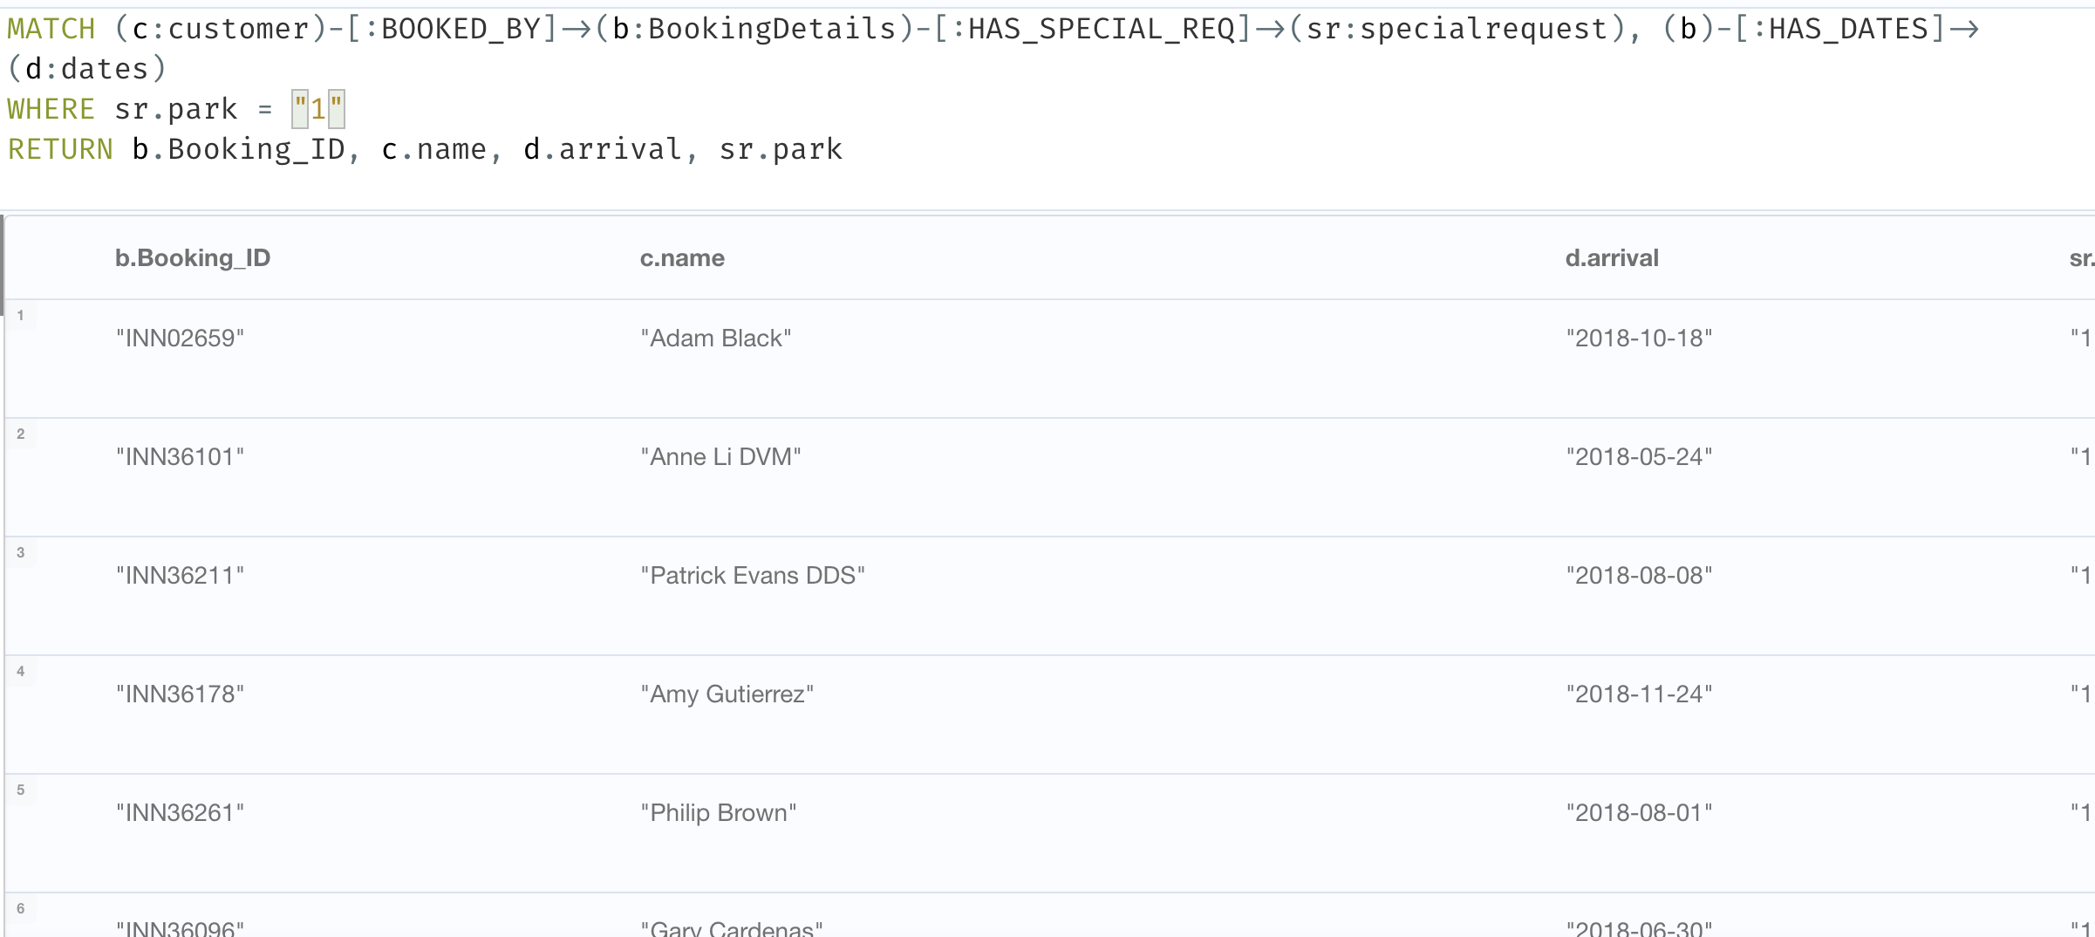
For Valet’s
\

Slide 20
Manager has asked to send promotional discounts to some of the customers for their next visit to the hotel. So, our team has decided to see who is visiting in our hotel for most number of days and likes visiting here often so we can send them discount coupons for their future visit.

Slide 21
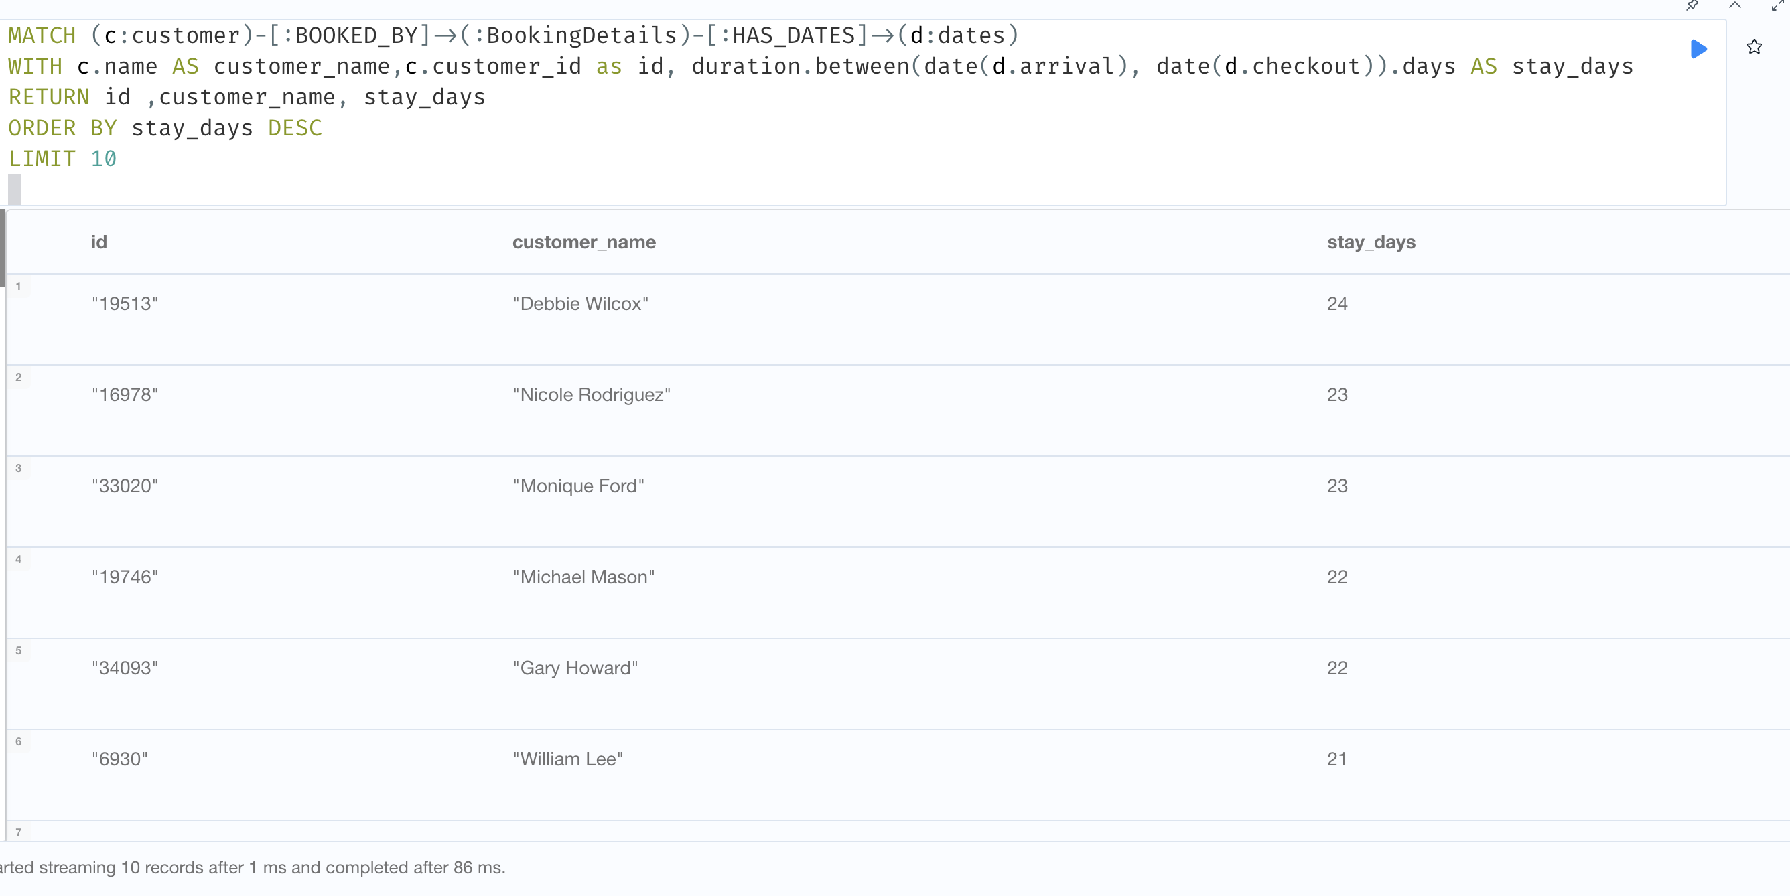
Our Loyal Customers

Slide 22
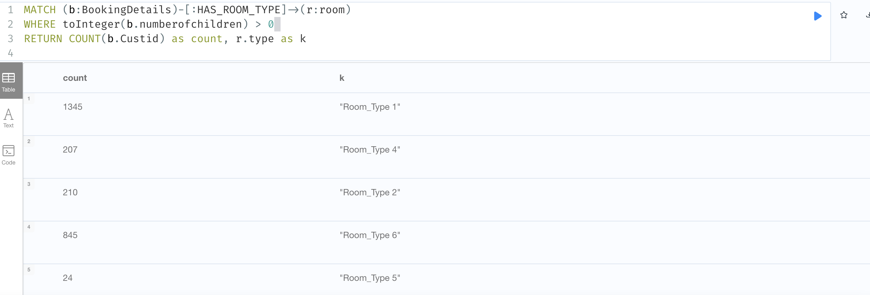
Preference of Room Type with Children

Slide 23
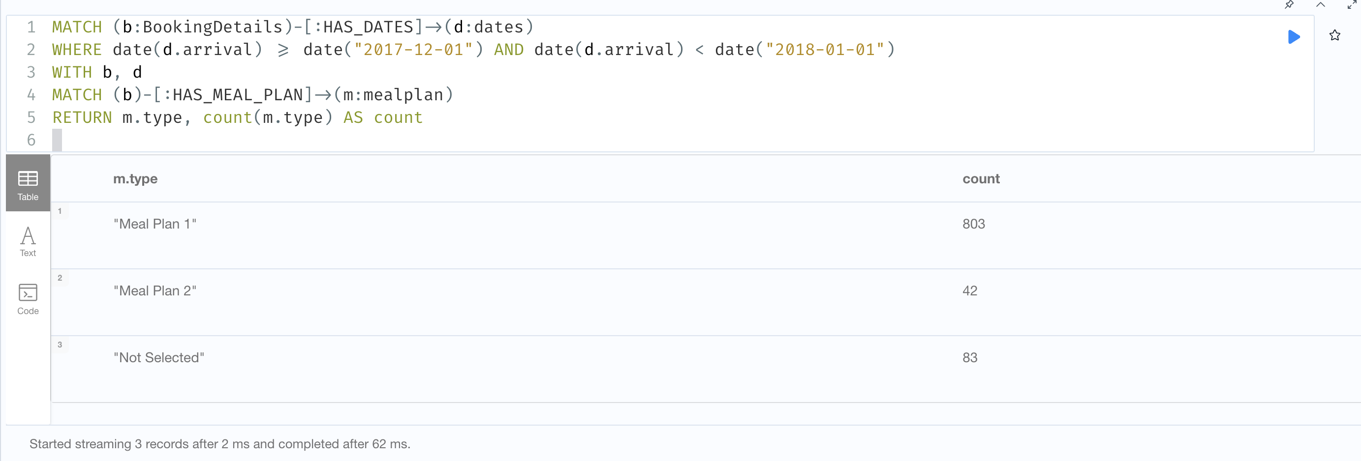
Meal Preference During Festivities.

Slide 24
Conclusions And Experience
Increased cancellations and no-shows as a result of the growth of online hotel reservation channels have changed the way consumers book accommodations, but they have also made it more difficult for hotels to properly manage their revenue. In order to address these issues, hotels must employ approaches like dynamic pricing and overbooking in addition to utilizing data analytics and data analytics to optimize their pricing and forecast consumer behavior. In addition to improving the guest experience, hotels can do this by reducing the income impact of cancellations and no-shows.

Slide 25
Thank you

